Slide 1


CREDIT CARD FRAUD DETECTION SYSTEM
This project addresses the critical challenge of detecting credit card fraud using advanced machine learning techniques. With the rise of online transactions, traditional methods fall short in identifying evolving fraudulent patterns. The system leverages models like Random Forest, Logistic Regression, and HistGradientBoostingClassifier, enhanced by feature transformation through Fast Fourier Transform (FFT) to improve prediction accuracy.
Presented by
Pallapati Pavan Kumar
12217293

Slide 2
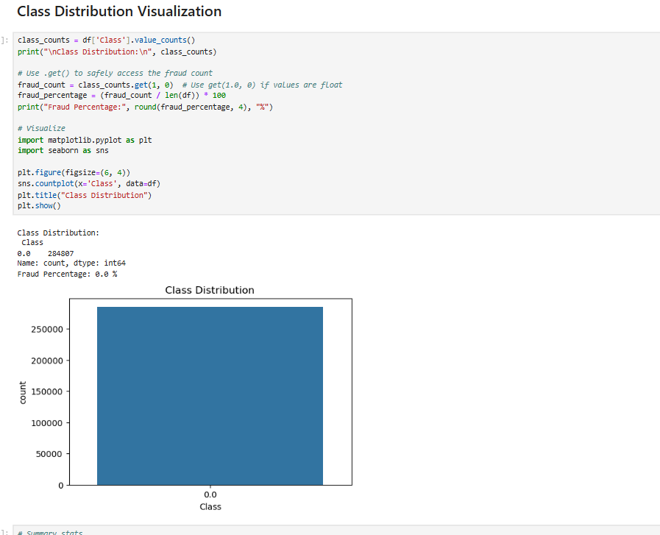
Dataset Description and Relevance
Dataset Overview
The dataset contains 284,807 transactions from European cardholders over two days in 2013, with 492 fraudulent cases (0.172%). It includes 30 features: 28 PCA components, Time, Amount, and Class (target variable).
Relevance and Quality
It reflects real-world anonymized transactions, with no missing values and scaled features. The high class imbalance requires specialized handling during model training and evaluation.

Slide 3
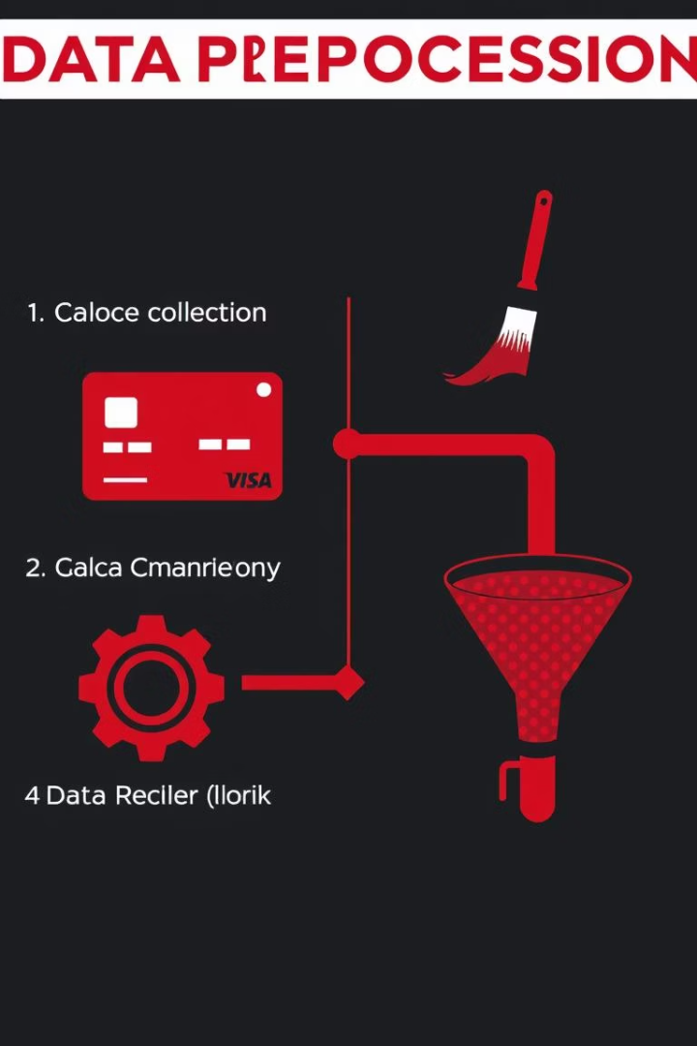
Data Preprocessing and Cleaning
Missing Values
Outlier Handling
The dataset is clean with no missing values, allowing direct model application without imputation.
Outliers in legitimate transactions were mitigated using Z-score and IQR methods, while preserving all fraud cases as anomalies.
Normalization
Time and Amount features were normalized using StandardScaler to improve model convergence; PCA features were already scaled.

Slide 4
Feature Selection and Engineering
Selected Features
Engineering Steps
28 PCA-transformed features (V1 to V28)
Normalization of Amount
Amount (normalized)
Correlation analysis to avoid multicollinearity
The Time feature was excluded in some experiments due to minimal predictive power.
Stratified sampling to handle class imbalance

Slide 5
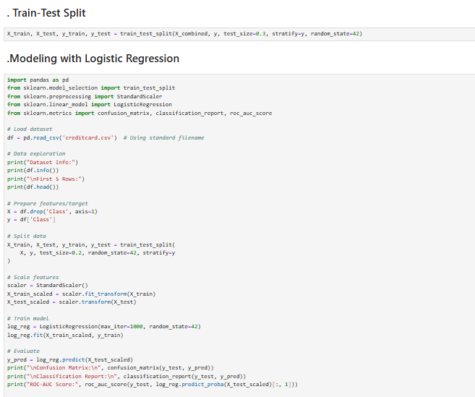


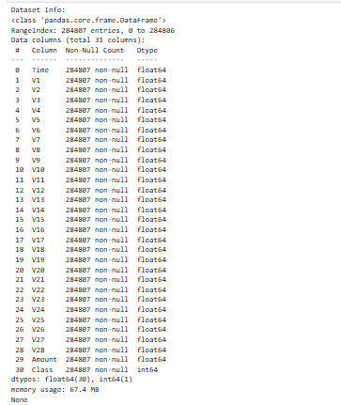

Model Selection and Justification
Logistic Regression
Implemented with balanced class weights and pipeline for imputation; suitable for baseline classification.
Random Forest
Ensemble of 100 trees with depth and sample constraints, handling class imbalance effectively.
HistGradientBoostingClassifier
Optimized gradient boosting model for large datasets, showing high accuracy and AUC-ROC scores.

Slide 6
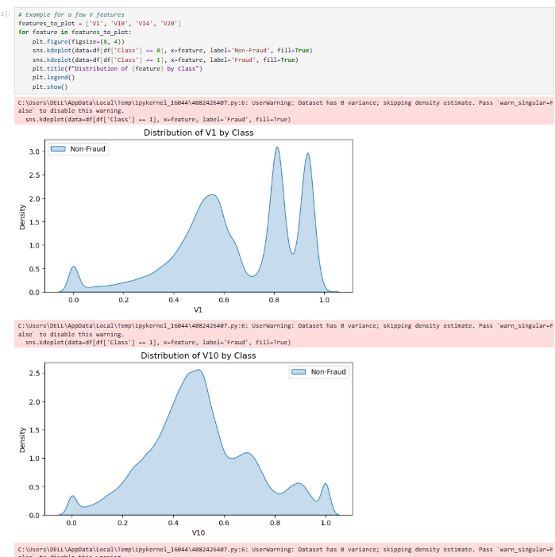
Methodology and Evaluation
Train-Test Split
Dataset split into 80% training and 20% testing to evaluate model generalization on unseen data.
Model Training
Each model trained using scaled features and balanced class weights to address data imbalance.
Evaluation Metrics
Models assessed using precision, recall, F1-score, and AUC-ROC to measure fraud detection performance.

Slide 7
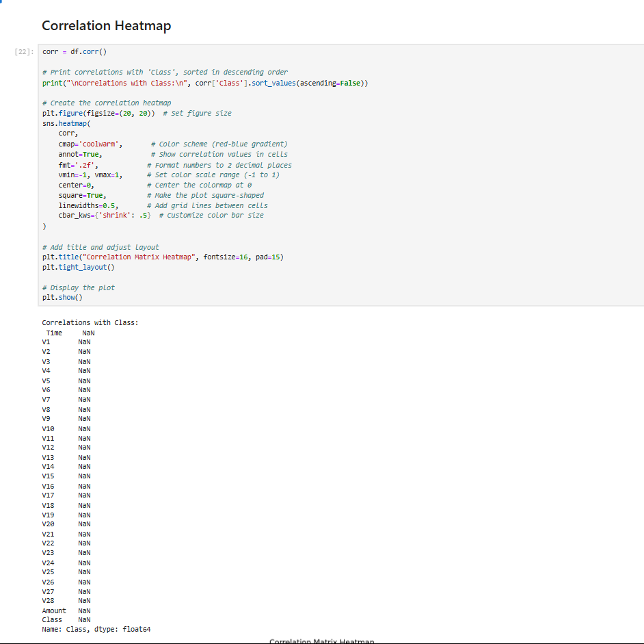
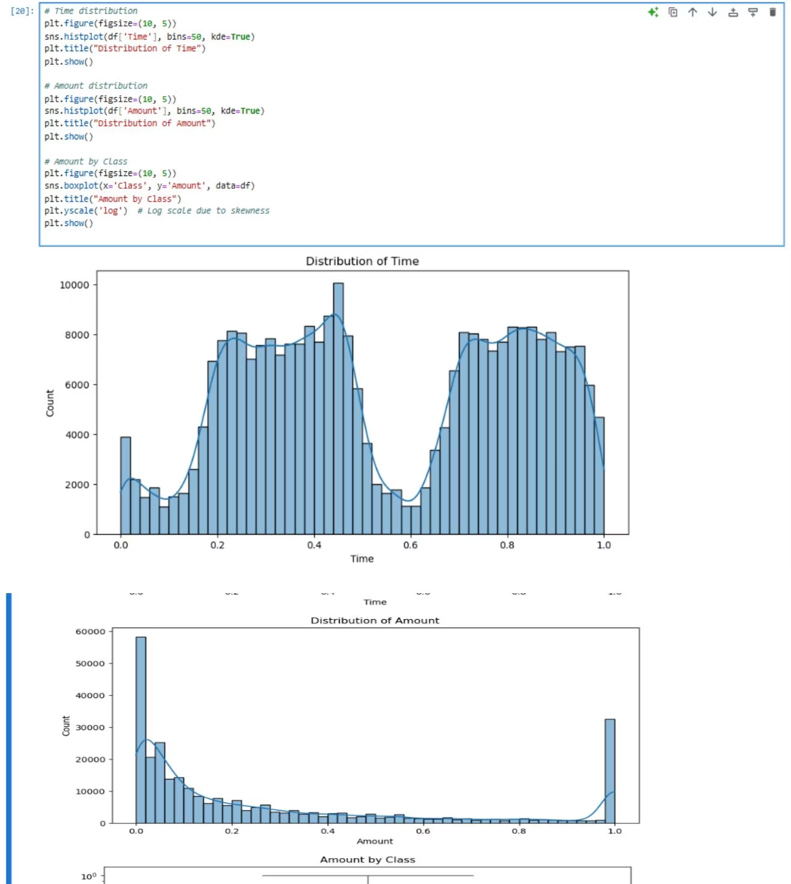
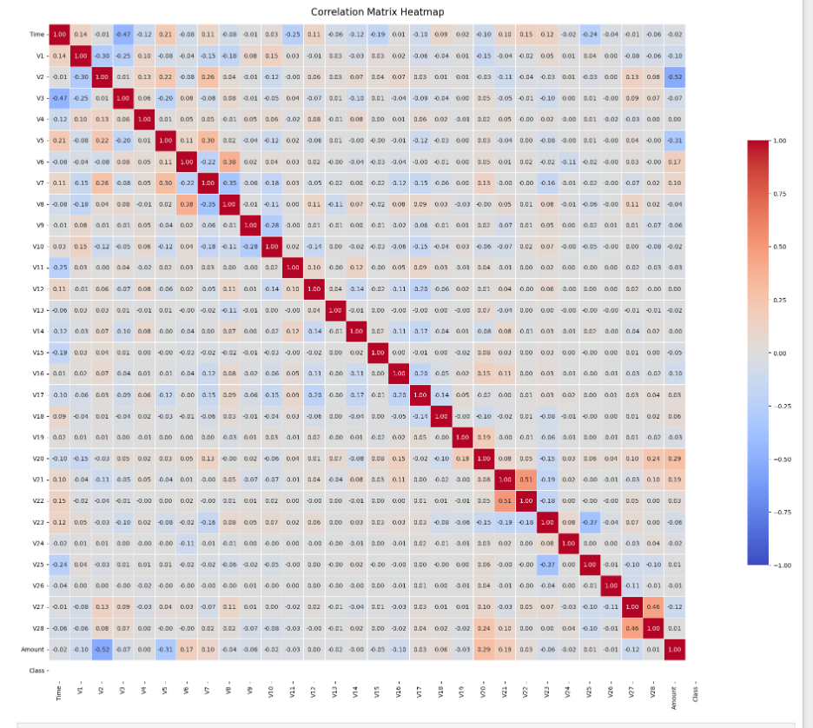
Results and Analysis
Class Distribution
Feature Insights
Fraudulent transactions are extremely rare, making up only 0.172% of total data, highlighting class imbalance challenges.
Summary statistics and kernel density plots reveal distinct patterns between fraud and non-fraud cases, aiding classification.

Slide 8

Key Takeaways and References
Takeaways
Machine learning models effectively detect credit card fraud despite data imbalance.
Feature engineering and preprocessing are critical for model accuracy.
HistGradientBoostingClassifier showed the highest ROC-AUC score among tested models.
References
Studies highlight the use of hybrid models, anomaly detection, and intelligent sampling to improve fraud detection accuracy.

